Slide 1
TEAM !XENON
The Maze game

Slide 2

Our Team
• GNMilev19 - Scrum Trainer
• VLMladenov19 - Back-end Developer
• SMDimitrov19 - QA Developer
• ZDNanev19 - Front-end Developer

Slide 3
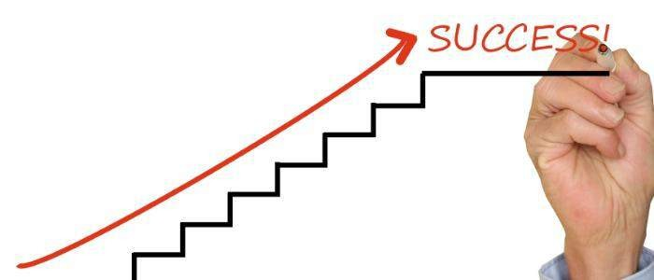
Stages of realization
1.We had had a lot of meetings, where we discussed who and what is going to do.
2.After giving away the tasks each one of us had to do, we started to realize them.
3.Everything was pretty much okay, we almost had not have any problems.
4.This is where we are now, and where the code is already realized and the game is ready to play

Slide 4





Technologies we used

Slide 5
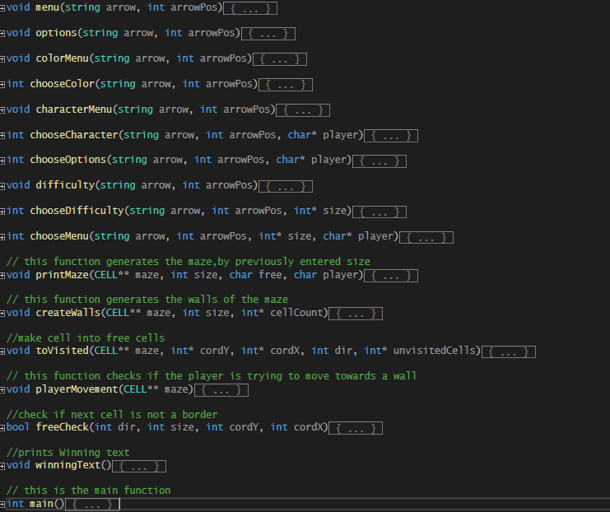
Functions we used for developing the game.

Slide 6
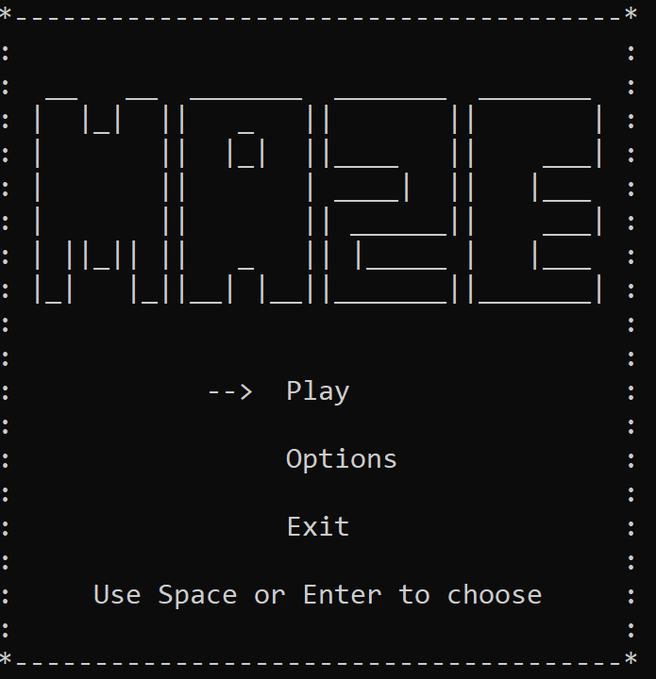
Showing off the menu

Slide 7


Slide 8
Thank you for your attention!

